Slide 1
Design Patterns
Unit 16
The Facade Pattern

Slide 2
Objectives
In this lesson, you will learn to:
The Facade Pattern

Slide 3
The Facade Pattern
Intent
  Provide a unified interface to a set of interfaces in a subsystem. Façade defines a higher-level interface that makes the subsystem easier to use.
Motivation
  Structuring (组织) a system into subsystems helps reduce complexity
  Subsystems are groups of classes, or groups of classes and other subsystems
  The interface exposed by the classes in a subsystem or set of subsystems can become quite complex
  One way to reduce this complexity is to introduce a facade object that provides a single, simplified interface to the more general facilities of a subsystem

Slide 4
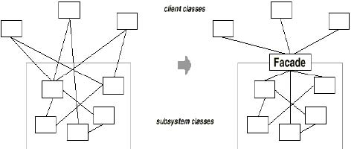
The Facade Pattern
Motivation
Notes:
医院门诊

Slide 5
The Facade Pattern
Applicability
Use the Facade pattern when:
  To provide a simple interface to a complex subsystem. This interface is good enough for most clients; more sophisticated (有经验的) clients can look beyond the facade.
  To decouple the classes of the subsystem from its clients and other subsystems, thereby promoting (促进) subsystem independence and portability

Slide 6
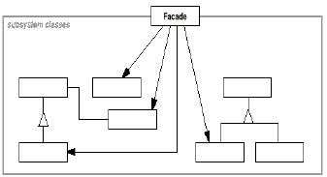
The Facade Pattern
Structure

Slide 7
The Facade Pattern
Consequences
  Benefits
    It hides the implementation of the subsystem from clients, making the subsystem easier to use
    It promotes weak coupling between the subsystem and its clients. This allows you to change the classes and the components of the subsystem without affecting the clients.
    It reduces compilation dependencies in large software systems
    It simplifies porting systems to other platforms, because it's less likely that building one subsystem requires building all others
    It does not prevent sophisticated clients form accessing the underlying classes
    Note that Facade does not add any functionality, it just simplifies interfaces
  Liabilities
    It does not prevent clients from accessing the underlying classes!

Slide 8
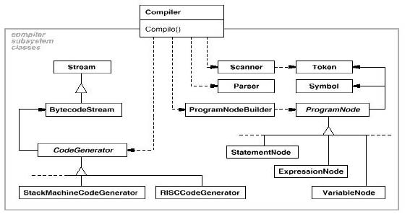
Facade Pattern Example 1
A compiler

Slide 9
Security with no Facade Pattern Example 2
public class Alarm {
public void activate() {
System.out.println("Activating the alarm.");
}
public void deactivate() {
System.out.println("Deactivating the alarm.");
}
public void ring() {
System.out.println("Ringing the alarm.");
}
public void stopRing() {
System.out.println("Ringing stopped.");
}
}

Slide 10
Security with no Facade Pattern Example 2
public class Sensor {
public void activate() {
System.out.println("Activating the sensor.");
}
public void deactivate() {
System.out.println("Deactivating the sensor.");
}
public void trigger() {
System.out.println("The sensor has been triggered.");
}
}

Slide 11
Security with no Facade Pattern Example 2
public class Light {
public void turnOn() {
System.out.println("Turning on the camera.");
}
public void turnOff() {
System.out.println("Turning off the camera.");
}
public void changeBulb() {
System.out.println("changing the light-bulb.");
}
}

Slide 12
Security with no Facade Pattern Example 2
public class Camera {
public void turnOn() {
System.out.println("Turning on the camera.");
}
public void turnOff() {
System.out.println("Turning off the camera.");
}
public void rotate(int degrees) {
System.out.println("rotating the camera by " + degrees + " degrees.");
}
}

Slide 13
Security with no Facade Pattern Example 2
public class Client {
/**
* @link aggregation
*/
static private Camera camera1, camera2;
/**
* @link aggregation
*/
static private Light light1, light2, light3;
/**
* @link aggregation
*/
static private Sensor sensor;

Slide 14
Security with no Facade Pattern Example 2
public static void main(String[] args) {
camera1.turnOn();
camera2.turnOn();
light1.turnOn();
light2.turnOn();
light3.turnOn();
sensor.activate();
alarm.activate();
}
}

Slide 15
Security with Facade Pattern Example 3
public class SecurityFacade {
/**
* @directed*/
private Camera camera1, camera2;
/**
* @directed
*/
private Light light1, light2, light3;
/**
* @directed*/
private Sensor sensor;
/**
* @directed*/
private Alarm alarm;

Slide 16
Security with Facade Pattern Example 3
public void activate() {
camera1.turnOn();
camera2.turnOn();
light1.turnOn();
light2.turnOn();
light3.turnOn();
sensor.activate();
alarm.activate();
}

Slide 17
Security with Facade Pattern Example 3
public void deactivate() {
camera1.turnOff();
camera2.turnOff();
light1.turnOff();
light2.turnOff();
light3.turnOff();
sensor.deactivate();
alarm.deactivate();
}
}

Slide 18
Summary
The Facade Pattern

